Slide 1
Correcting for bias in the estimation of proportions by pooled testing
Graham Hepworth¹ & Brad Biggerstaff ²
¹Statistical Consulting Centre,The University of Melbourne
²Centers for Disease Control and Prevention, U.S.A.

Slide 2

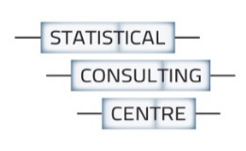

80 mosquitoes
Testing pools (groups) of mosquitoes to estimate the prevalence p of West Nile Virus

Slide 3
80 mosquitoes

Slide 4
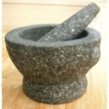
80 mosquitoes

Slide 5

80 mosquitoes

Slide 6
80 mosquitoes

Slide 7
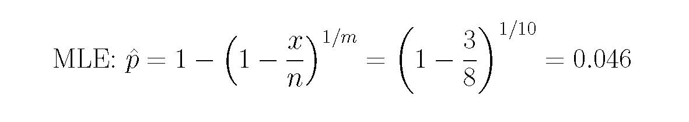
80 mosquitoes
n pools of m,
x pools positive
The estimator is positively biased.

Slide 8
Unequal pool sizes
134 mosquitoes
MLE: found by iteration, and positively biased.

Slide 9
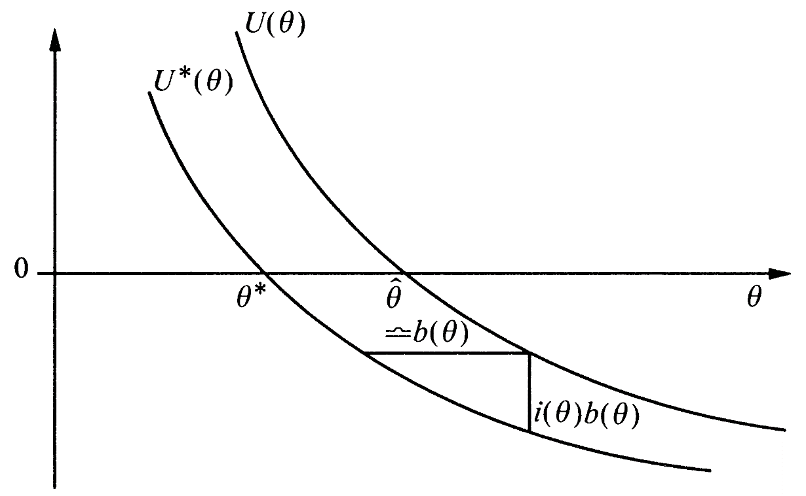
Firth’s bias correction of the MLE

Slide 10
Firth’s bias correction of the MLE: features
Removes bias of O(n^{–1}).
Generalises a very good method for equal pool sizes.
“Preventative” rather than corrective.
Avoids problems related to undefined parameter estimates.
Computationally straightforward.

Slide 11
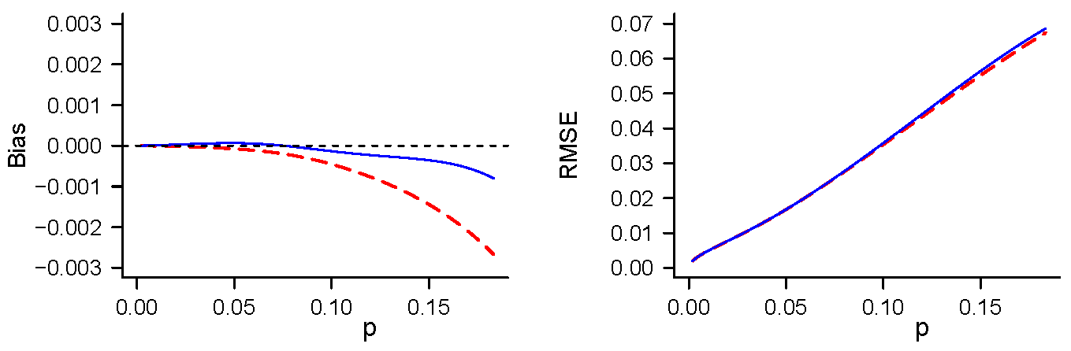
Bias of estimators: 500 individuals in
5 pools of 5, 5 pools of 10, 5 pools of 25, 6 pools of 50
(perfect testing)
Firth
Gart
(corrective)

Slide 12
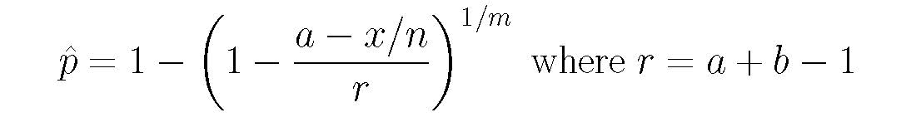
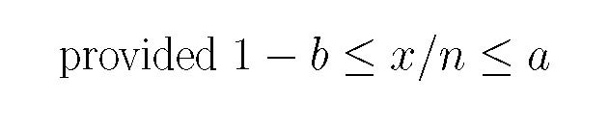
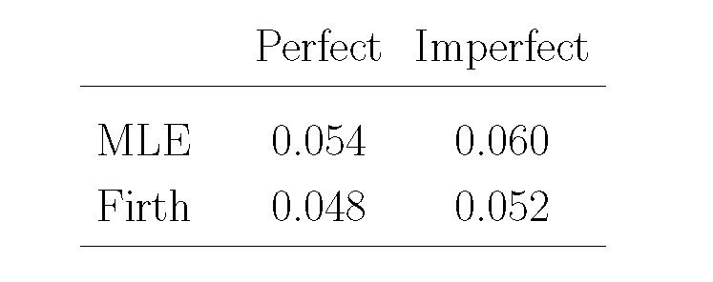
Imperfect testing: n pools of m, x pools positive
sensitivity = a; specificity = b
8 pools of 25,
6 pools positive,
a = 0.95, b = 0.99

Slide 13
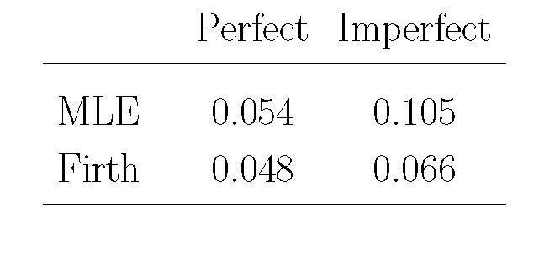
Imperfect testing: n pools of m, x pools positive
sensitivity = a; specificity = b
8 pools of 25,
6 pools positive,
a = 0.8, b = 0.99

Slide 14
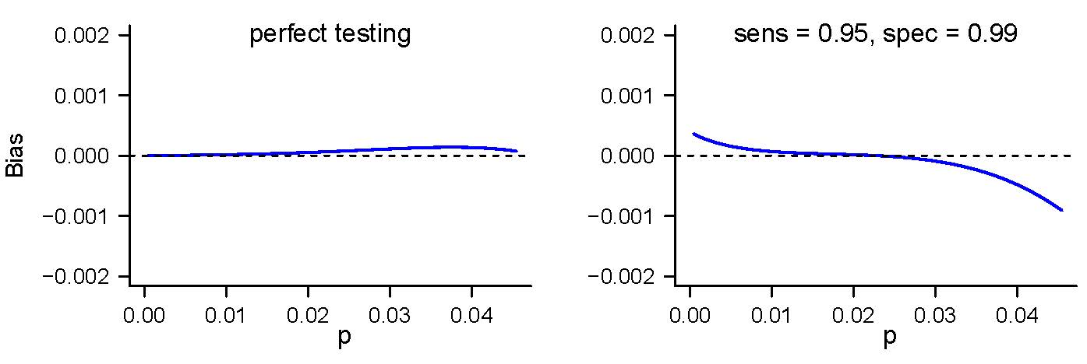
Bias of corrected estimator: 8 pools of 25

Slide 15
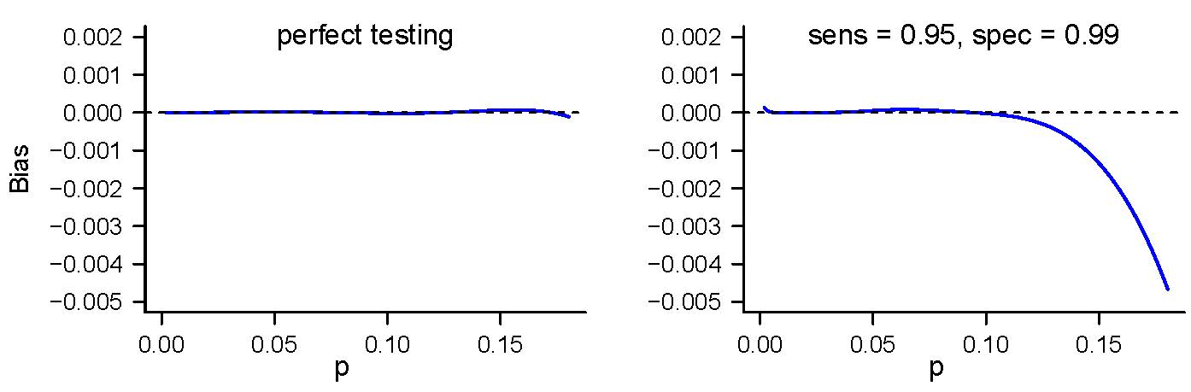
Bias of corrected estimator:
20 pools of 10, 8 pools of 25, 12 pools of 50

Slide 16
Summary
Pooled testing: MLE of p is biased, sometimes severely.
An estimator based on Firth’s general bias correction of the MLE is almost unbiased and has many excellent features.
The estimator can be extended to imperfect testing.
It is almost unbiased for p in the main region of interest.

Slide 17
Future work / Extensions
Sensitivity and specificity varying with pool size.
Uncertainty in sensitivity and specificity.
Interval estimation of p.

Slide 18
References
G. Hepworth & B.J. Biggerstaff (2017) Bias correction in estimating proportions by pooled testing. JABES 22:602–614.
G. Hepworth & B.J. Biggerstaff (2021) Bias correction in estimating proportions by imperfect pooled testing. JABES 26:90–104.
D. Firth (1993) Bias reduction of maximum likelihood estimates. Biometrika 80:27–38.
Acknowledgement: Financial support provided by Statistical Society of Australia, Victorian Branch.

